Slide 1
Robot Motion Models
Lecture 07-02
RBE500-F17-191
Prof. Julian Center

Slide 2
Using Sensor Data
Consider the problem of determining the location of a platform (or parts of a platform):
Relative position – we can determine position as a deviation from a known point
Absolute position – we can determine position within a known coordinate system

Slide 3
Relative Position
Determining relative position implies “dead reckoning”:
Assumes some known starting point.
Sensors measure some “advance” from that starting point.
Prone to accumulation of errors.
Errors may be reasonably bounded by periodic recalibration
Absolute fixes
Zero-velocity Updates
Etc.

Slide 4
Dead Reckoning Sensors
There are two basic types of sensors that provide data to a dead reckoning system:
Odometry – Odometry sensors measure displacement or orientation as a function of time.
Inertial – Inertial sensors measure physical parameters like acceleration or rotation relative to an inertial reference frame. (We will study inertial systems in a later lesson.)

Slide 5
Odometry Sensors
Odometry sensors are among the most common of robot platforms.
They take many forms:
Rotation sensors
Some kind of encoder is used to measure wheel rotation.
Knowing the amount of rotation and the wheel diameter a displacement can be determined.

Slide 6
Example Differential Drive Robot
Consider an example of a simple robot system which uses differential drive:

Slide 7
A Differential Drive Example
With both wheels driven, at any time, t, the system can be viewed as rotating along its instantaneous center of curvature (ICC):

Slide 8
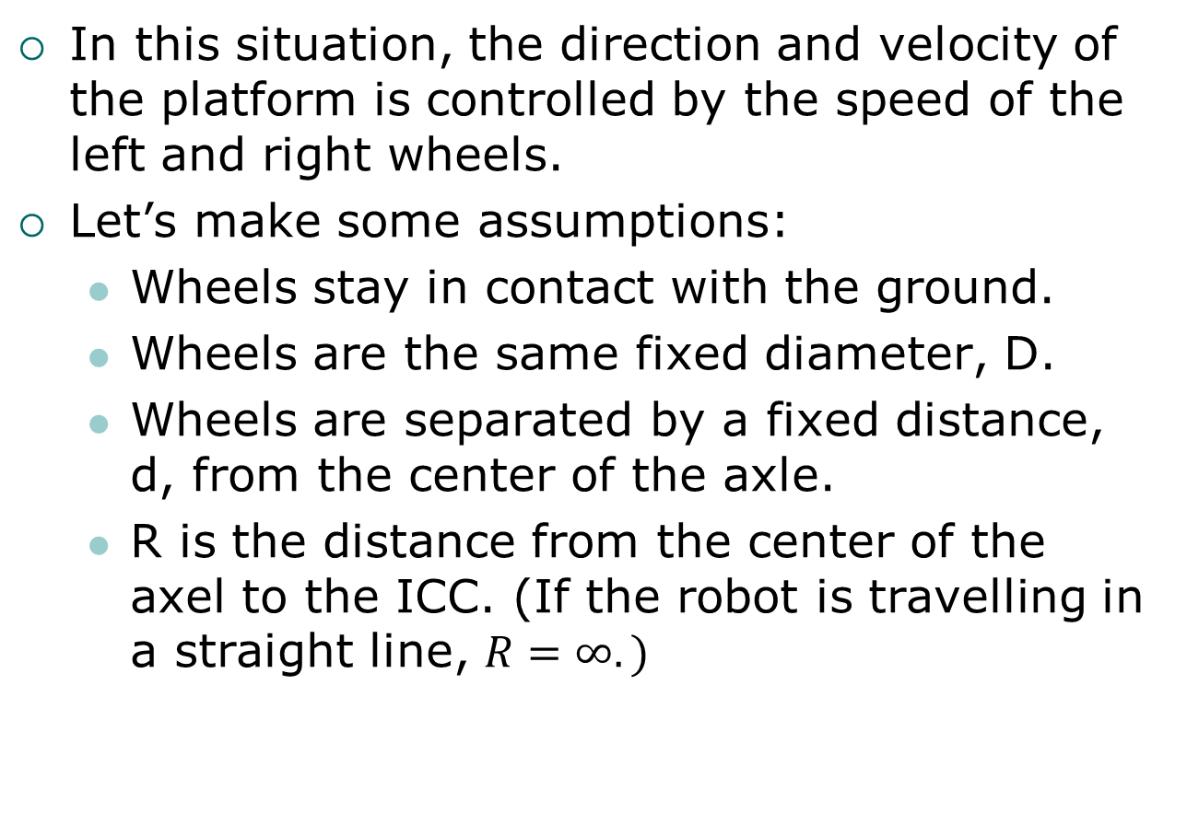
Differential Drive
In this situation, the direction and velocity of the platform is controlled by the speed of the left and right wheels.
Let’s make some assumptions:
Wheels stay in contact with the ground.
Wheels are the same fixed diameter, D.
Wheels are separated by a fixed distance, d, from the center of the axle.
R is the distance from the center of the axel to the ICC. (If the robot is travelling in a straight line, $R=∞.)$

Slide 9
Differential Drive Characteristics
Given this setup, if the velocity of the left wheel, v_{l}, and the right wheel, v_{r}, are the same, the platform will move straight.
Changing v_{l} or v_{r} allows differential steering of the platform to the left or right.
All of this is under the assumption that there is no slip.

Slide 10

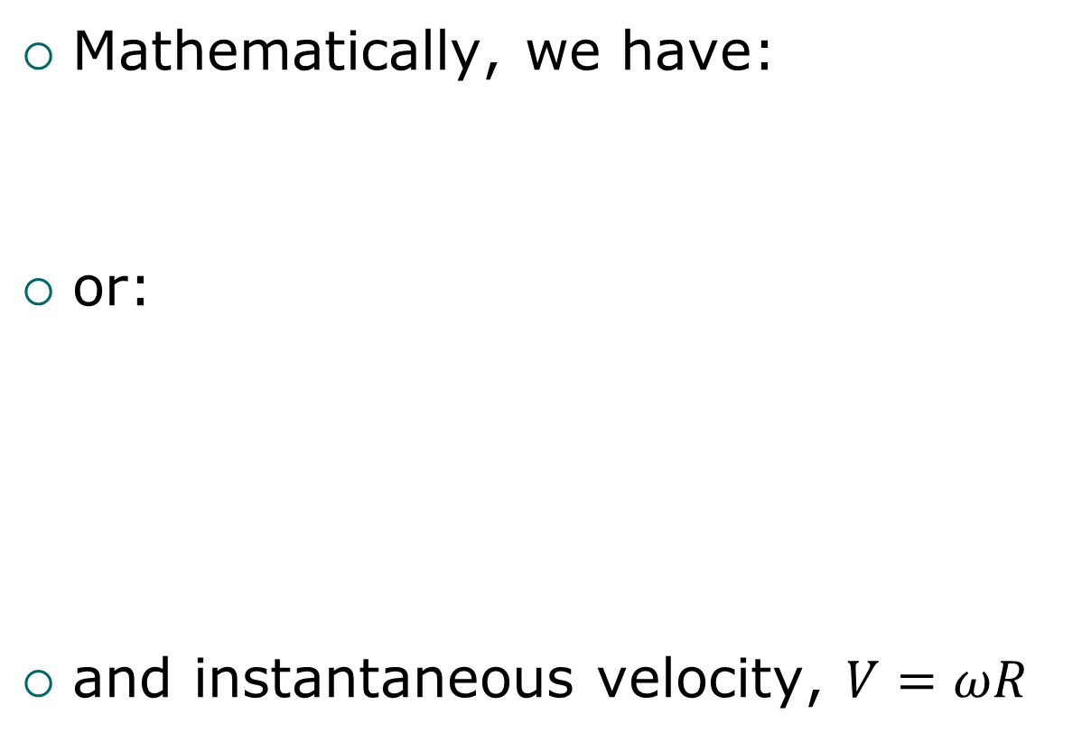



Differential Drive Equations
Mathematically, we have:
or:
and instantaneous velocity, $V=ωR$
$$ω\left(R−d\right)=v_{r}$$
$$ω\left(R+d\right)=v_{l}$$
$$ω=\frac{\left(v_{l}−v_{r}\right)}{2d}$$
$$R=d\frac{\left(v_{l}+v_{r}\right)}{\left(v_{l}−v_{r}\right)}$$

Slide 11
Determining Position and Orientation
At any given point in time, t, the left and right velocities of the wheels can be known:
For example, by using an encoder to measure amount of wheel rotation
Assuming the center of the axle is the origin for the robot platform, we can calculate the position and orientation of the robot as a function of time.

Slide 12
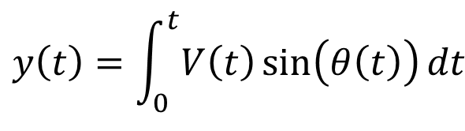

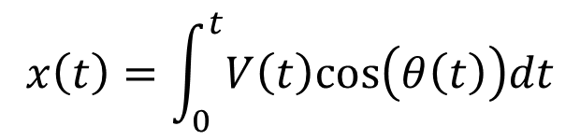
Determining Position and Orientation
Assuming a Cartesian coordinate system:
$$x\left(t\right)=\int_{0}^{t}{V\left(t\right)cos⁡\left(θ\left(t\right)\right)dt}$$
$$y\left(t\right)=\int_{0}^{t}{V\left(t\right)\sin{⁡\left(θ\left(t\right)\right)}dt}$$
$$θ\left(t\right)=\int_{0}^{t}{ω(t)dt}$$

Slide 13
Accumulated Errors
It is in the underlying assumptions (and the integration) that result in accumulated errors:
Mechanical tolerances on wheel spacing and diameter.
Electrical/mechanical tolerances measuring (and maintaining) wheel velocity

Slide 14
“Momentary” Errors
The integration that is part of dead reckoning means that even transient errors in determining orientation will result in a constantly increasing position error.
Further, any biases in the system are continuously “integrated in” to the position and orientation solution.

Slide 15
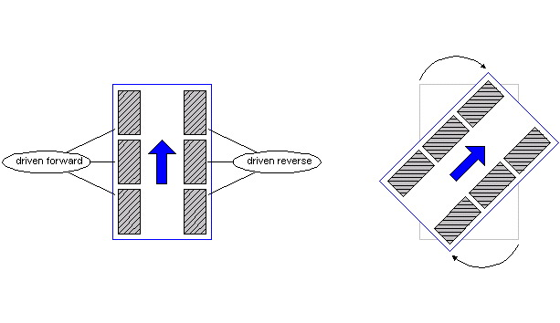
Many Robots Use Skid Steering
Pros: Behaves somewhat like differential drive. Can handle greater loads.
Con: Wheels are not moving on the same arc and therefore they skid, making odometry inaccurate.
http://groups.csail.mit.edu/drl/courses/cs54-2001s/skidsteer.html

Slide 16
Rotational Sensors
The skid-steer example is one simple way of controlling the velocity and orientation of a robot.
For other steering mechanisms, some indication of the orientation of the steering mechanism is needed.
As well as modifications to the math to account for the steering and drive having different origins.
Thus, we need rotational sensors.

Slide 17
Wheel Rotation Sensors
Wheel Rotation sensors come in a variety of forms:
Incremental encoders – determine displacement of a shaft from a known starting point
Absolute encoders – provide a direct indication of the position of a shaft.

Slide 18
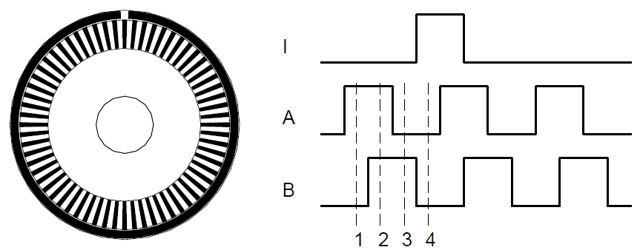
Incremental Encoder
A common example of an incremental encoder is a quadrature encoder.
Allows determining direction and amount of rotation:
Sensors
See: Edwin Olsen, “A Primer on Odometry and Motor Control,” 2004.
The pdf is in the Lecture 07 course module as “odomtutorial.pdf”

Slide 19
Quadrature Encoder Signals
Forward
A
c
c
c
c
c
B
c
c
c
c
c
Reverse
A
c
c
c
c
c
B
c
c
c
c
c

Slide 20
Incremental Encoders
Work well for measuring relatively small amounts of rotation
Limited only by optical resolution
“Index” provides a count of whole rotations.
Eventually quantization and missed interrupts cause missed counts.

Slide 21
Absolute Encoders
An absolute encoder provides a way to directly measure the orientation of a shaft:

Slide 22
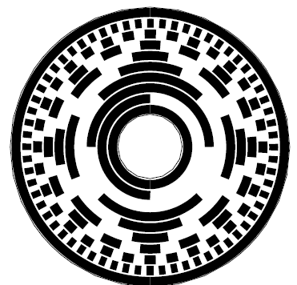
Absolute Encoder
These systems typically use a Gray-coded disk to allow encoding absolute shaft position”
These sensors tend to be most commonly used in low-speed applications needing 10-12 bits of resolution.

Slide 23
Heading Sensors
To detect drift while dead reckoning using odometry, it is possible to include other measures of orientation:
These may include:
Magnetometer / Compass
Angular rate sensor – Gyroscope.

